Slide 1
FORECASTING LETTUCE PRICES IN THE UK
Interns Group 6

Slide 2
CONTENTS
01.
02.
03.
04.
INTRODUCTION
OUR DATA
OUR APP
ADDITIONAL VALUE

Slide 3
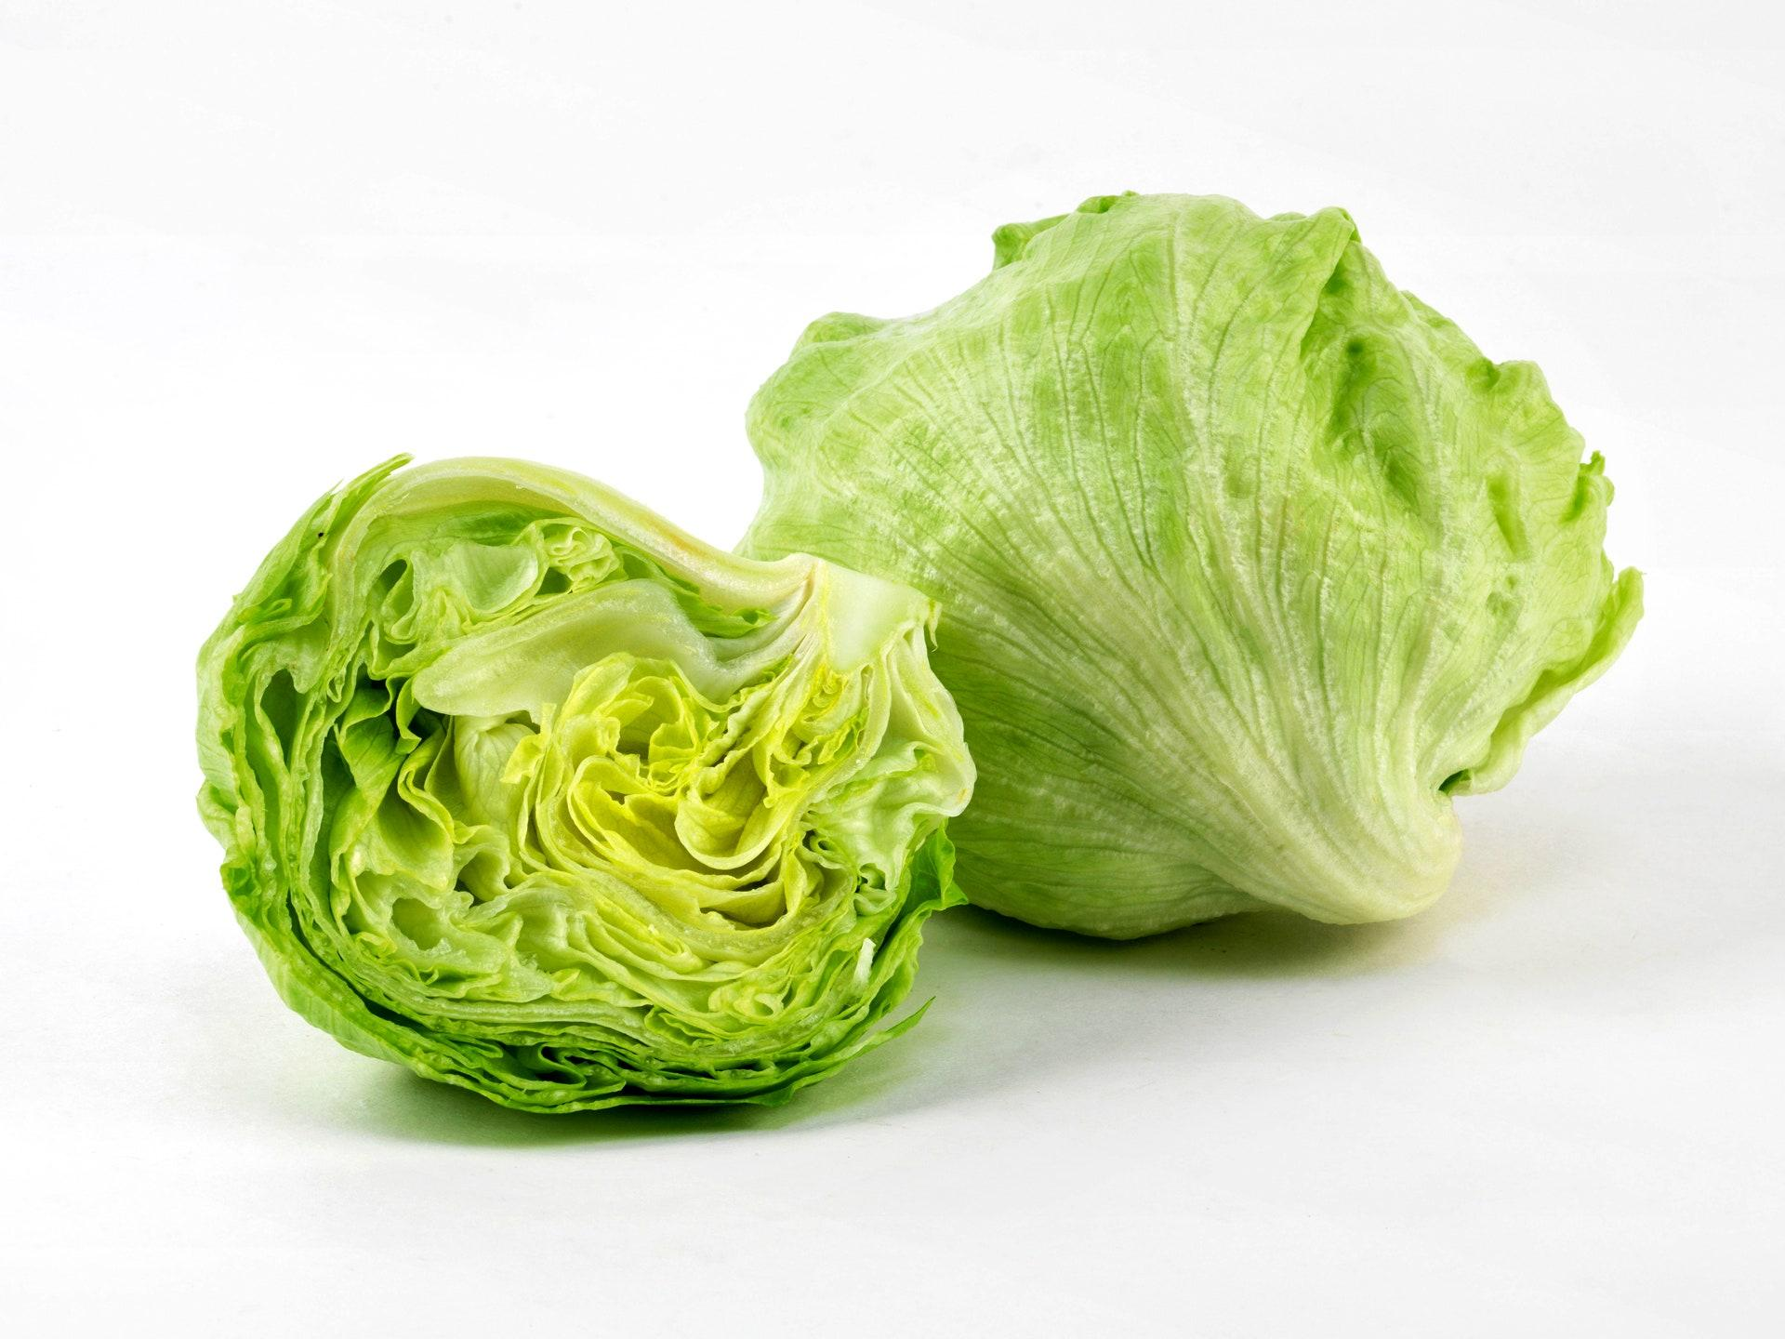
INTRODUCTION

Slide 4



Slide 5
LETTUCE SIGNIFICANCE
Lettuce is a major salad ingredient which is popular in the U.K.
Lettuce is one of the most versatile and valuable crops to grow in a polytunnel in the UK.

Slide 6
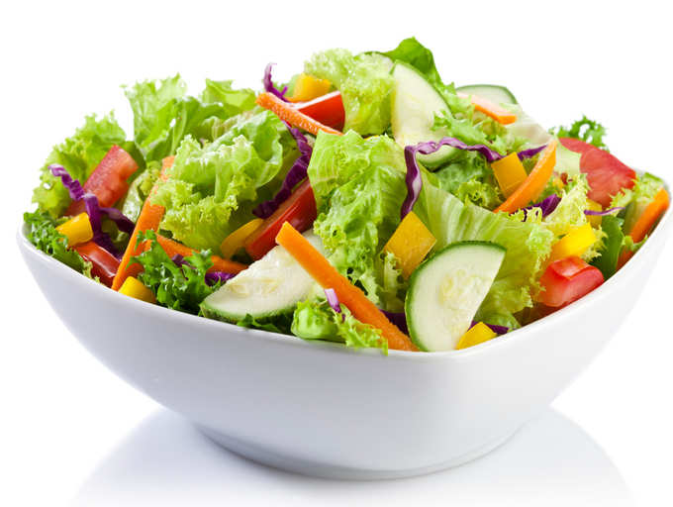
OUR DATA

Slide 7

FEATURES
5
378
COLUMNS
OBSERVATIONS
Date, Shop code, Region, Price, Item
Recorded observations for Lettuce
9
DATE
REGIONS
1988 to 2019

Slide 8
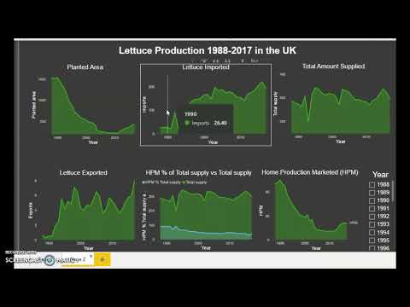
Dashboard Demo
Insights from UK lettuce Price data

Slide 9

TIME SERIES DATA

Slide 10
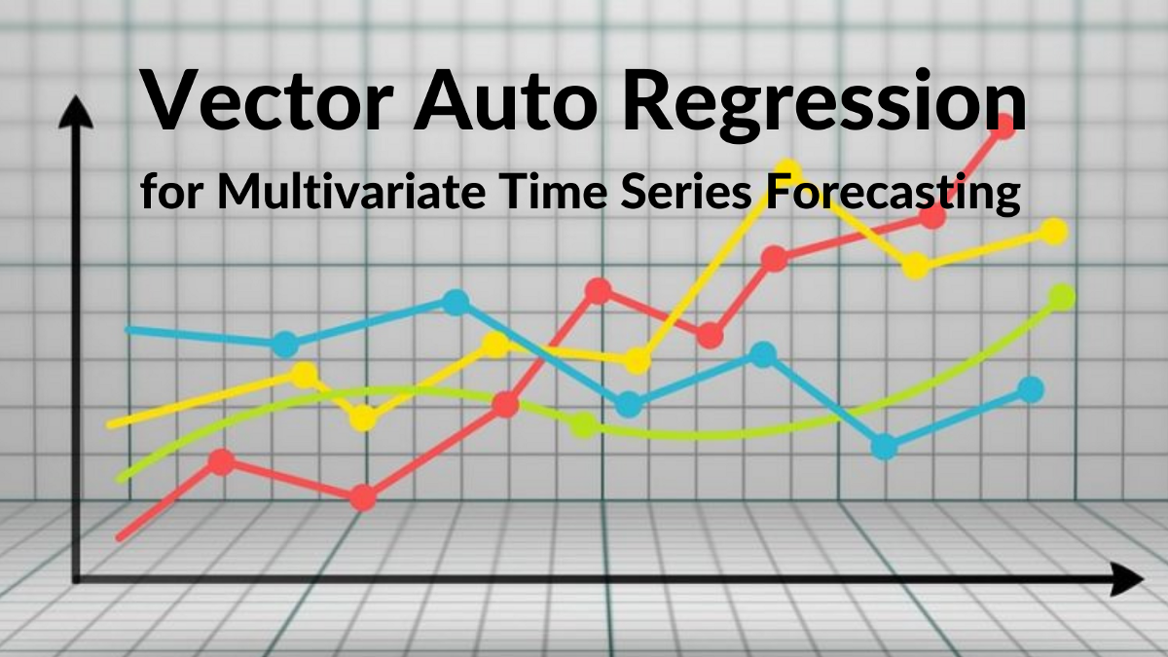
MODELLING
This model best fits time series data while factoring out seasonality.
VAR utilises previous monthly lettuce prices and the respective features to predict the future prices.

Slide 11
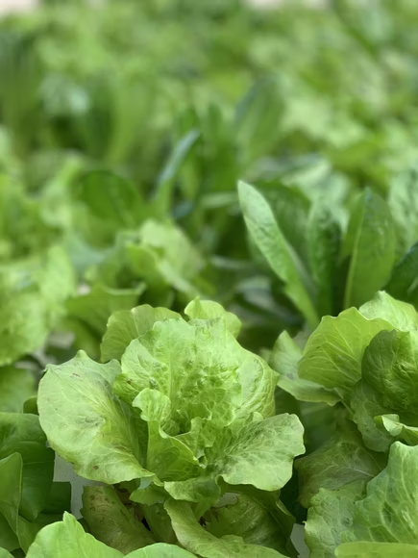
PRICER APP
Lettuce Price Predictor

Slide 12
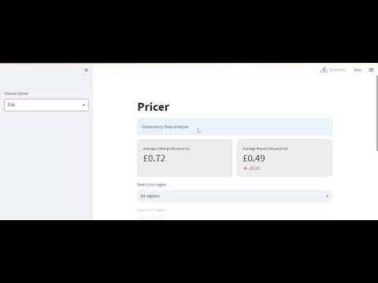
Pricer App Demo

Slide 13

APP IMPROVEMENTS
This app can be used to predict prices for other commodities
The app could also be useful in sending sales leads for the items it supports

Slide 14

APPRECIATION

Slide 15

IDEAS & QUESTIONS

Slide 16
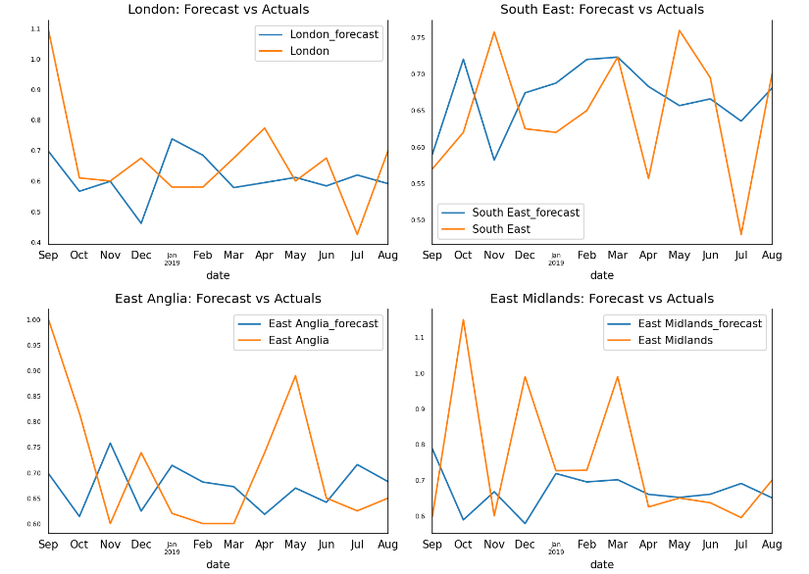

Slide 17
